Slide 1
Effect of Temperature Gradient on High speed track with Track-Bridge Interaction
International Technical Seminar of IPWE (India) -2017
Presented
by
Sandip Kumar Saha
Divisional Engineer/East/Ranchi
South Eastern Railway

Slide 2
INTRODUCTION
High Speed Track
Increase static & dynamic load
Easy maintainability
Riding comfort
Safety
Long Welded Rail (LWR)

Slide 3
challenges
Longitudinal forces & axial compressive stresses in LWR track on long-span bridges due to temperature variations
Selection of economic structure
Problems with rail expansion devices
Complex phenomenon of Track-Bridge interaction

Slide 4
Associated factors affecting track-bridge interaction
Additional horizontal forces in rails and bridge girders the design of bearings and substructures
Temperature variation
Thermal expansion of deck (CWR)
Thermal expansion of the deck and rails in the presence of expansion devices
Horizontal braking and accelerating forces
End rotations of the deck due to vertical traffic loads
Deformation of the supporting concrete structure due to creep and shrinkage

Slide 5
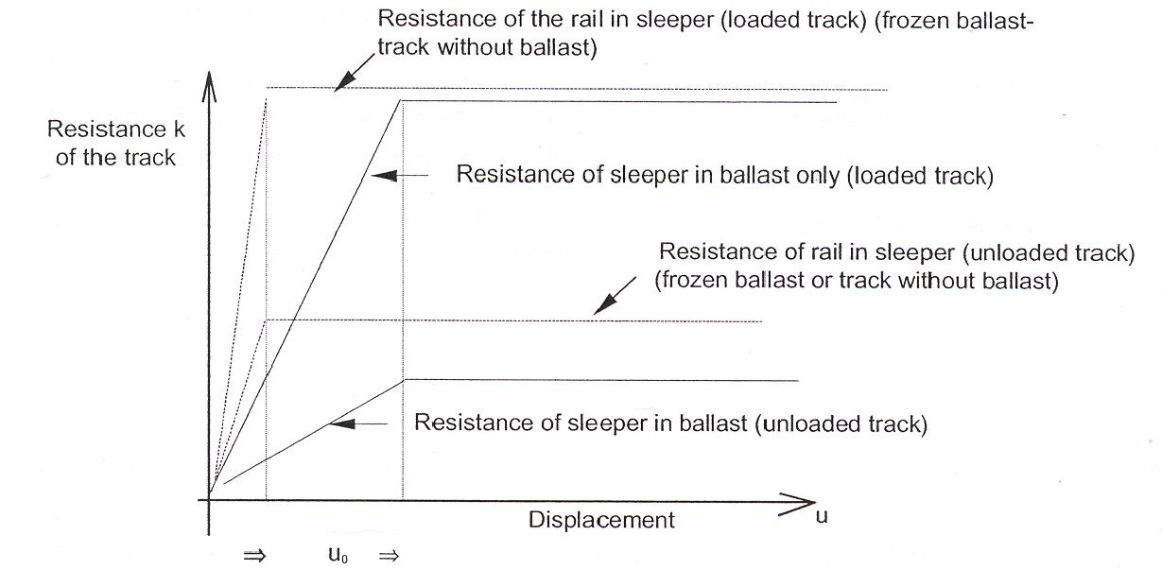
Interaction between track and bridge deck
Bilinear relationship between resistance and displacement of track
LWR track induces additional force into the bearings of bridge deck
Movement of deck induces additional force on LWR

Slide 6
Variations of temperature
The UIC 774-3R code considers the following aspects of temperature variations
Changes in the uniform component of the temperature which causes a change in length in a free moving structure
Differences in temperature between the deck and the rails, in the case of track with expansion devices

Slide 7
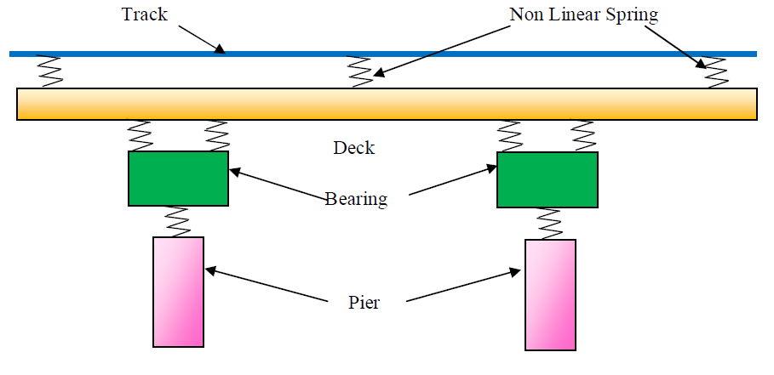
Numerical modelling of track-bridge interaction
Simulate the track–bridge interaction based on stiffness approach & springs as axially loaded truss elements

Slide 8
Effect of change in temperature gradient
Rate of decrease in LWR Force with decrease in temp. gradient is much higher than that of increase gradient
At a particular value of temperature gradient, the LWR forces get reversed, i.e. from compression to tension and vice-versa
Bending is more predominant in the deck-type bridges than the continuous-type

Slide 9
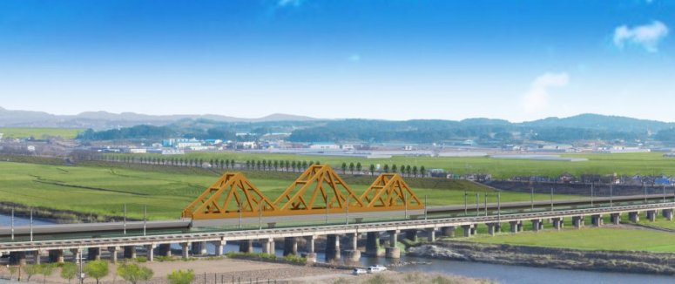
Case study-Honam high speed railway bridge
Interaction analysis done for a 1.8km long viaduct bridge structure with 3-span centre section of steel box framed construction
Temp. change and the passage of trains on different tracks accelerating or braking across the structure induce axial compressive forces in the rails and displacements in rails relative to the bridge deck

Slide 10
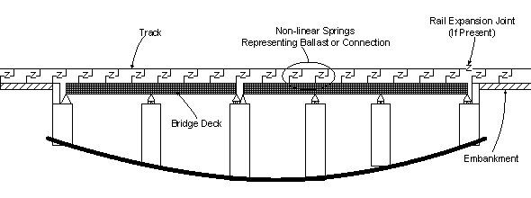
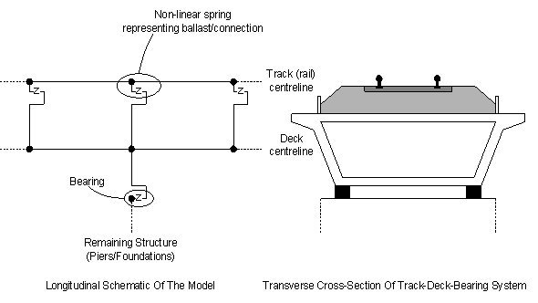
Structure System and Track/Deck Modelling
The bridge is simplified and broken down into beam elements which represent the track and any supporting structure
Nonlinear springs being used to model the ballast and expansion joints
Bearings and foundations are modeled with simple springs

Slide 11
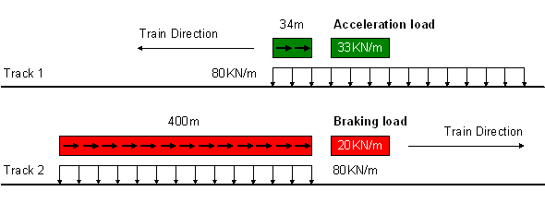
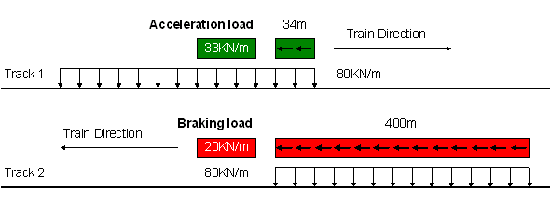
Train loading configuration straight and reverse directions

Slide 12
Compressive stresses in the rails for simple (beam only) and full (including framed steel members) models
Temp. and accl. load
Temp. and braking load

Slide 13
Results & Analysis
From created graphs for both the simple model (using beams only) and the full model (which additionally modeled the framed steel members) showed the variation of axial compressive stress in the rails as a result of the temperature and acceleration / braking loading
From these graphs it was seen that full modeling of the steel framed members produced a reduced axial compressive stress in the track over that shown for the simple beam only model for temperature effect

Slide 14
conclusion
The significance of track-bridge interaction studies has increased at present scenario for high speed track
In the present study, the effect of temperature gradient on this phenomenon is studied by developing a numerical model by standard software package
The complex phenomenon is tried to understand by already performed numerical modeling and their results for Honam Railway Bridge

Slide 15
conclusion
The parametric study shows that the influence of temperature gradient on the LWR Force is very significant and needs to be accounted for. The support reactions are influenced considerably
The variation of axial compressive stress in the rails as a result of the temperature and acceleration / braking loading. Full modeling of the steel framed members produced a reduced axial compressive stress in the track It will play a significant role for cost-benefit analysis
Railway codes are slient about the effect of temperature gradient in the design of bridges with track-bridge interaction analysis and should be included in bridge code or LWR manual.

Slide 16
THANK YOU

